Slide 1



ATLIQ HARDWARE
Business Insight 360
Domain: Fast Moving Consumer Goods
Presented by
Aditya Rajvaidya

Slide 2
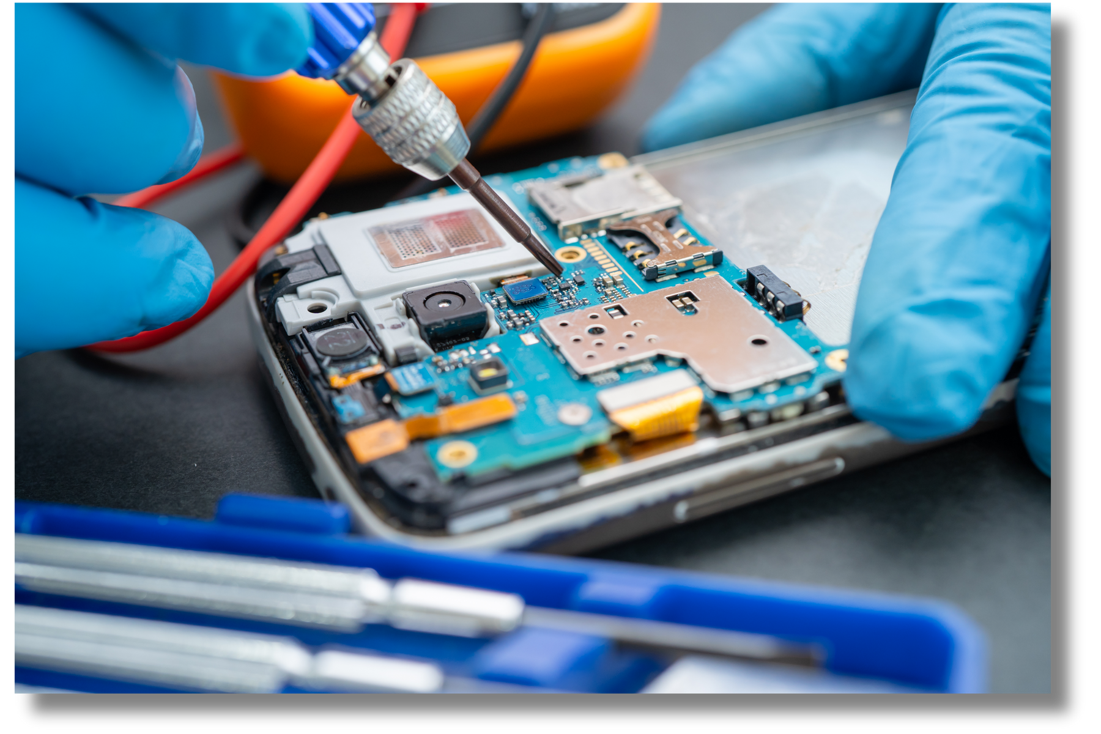

Company Overview
AtliQ Hardware is a global leader in manufacturing and delivering premium computer hardware, catering to diverse markets and regions with innovation, reliability, and excellence.

Slide 3

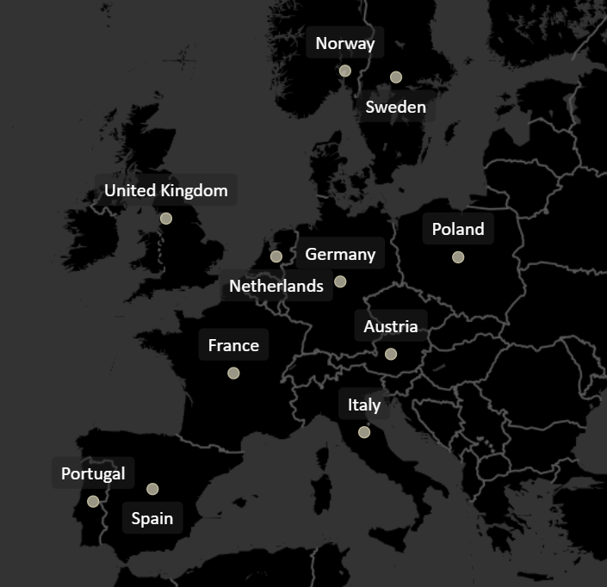
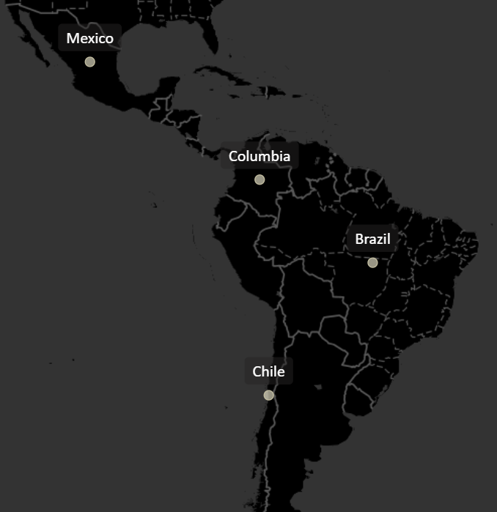
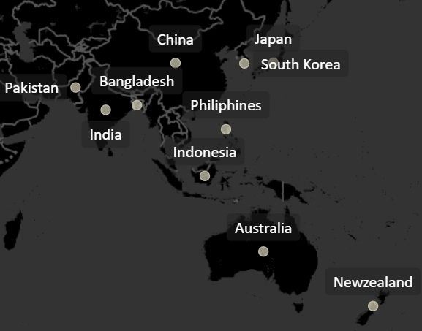
MARKETS
NA
EU
LATAM
APAC

Slide 4
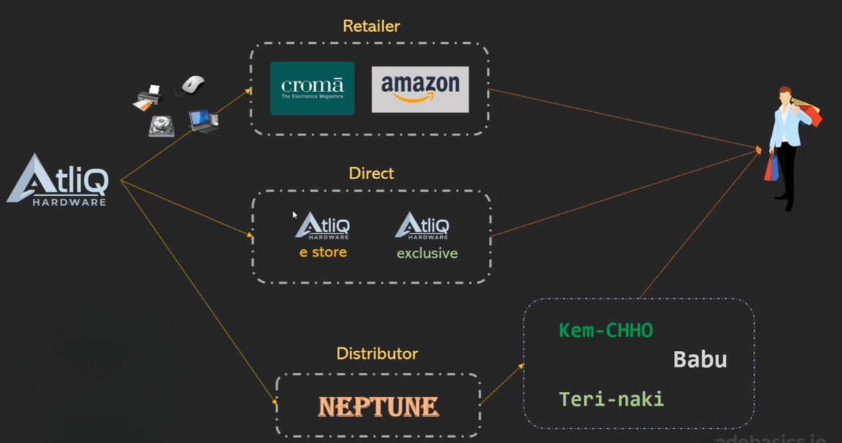
SALES CHANNEL AND PRODUCT LINE
PC
Notebook
Desktop
Gaming Laptop
Personal Laptop
Business Laptop
Business Laptop
Personal Laptop
N & S
Storage
Networking
External SSD
USB Flash Drives
Wi-Fi Extender
P & A
Peripherals
Graphic Card
Motherboard
Internal HDD
Processors
Accessories
Batteries
Keyboard
Mouse

Slide 5
WHY THIS PROJECT NEEDED?
Well, this project was crucial because Atliq Hardware faced major challenges in its Latin American operations. Why?
Many business decisions relied on gut feeling rather than data-driven insights, leading to inaccurate forecasts and inefficiencies.
Without a systematic data analysis process, AtliQ struggled to identify trends and truly understand customer behaviour.
The Latin American market was highly competitive, with other players leveraging data for a competitive edge—something AtliQ Hardware lacked.

Slide 6
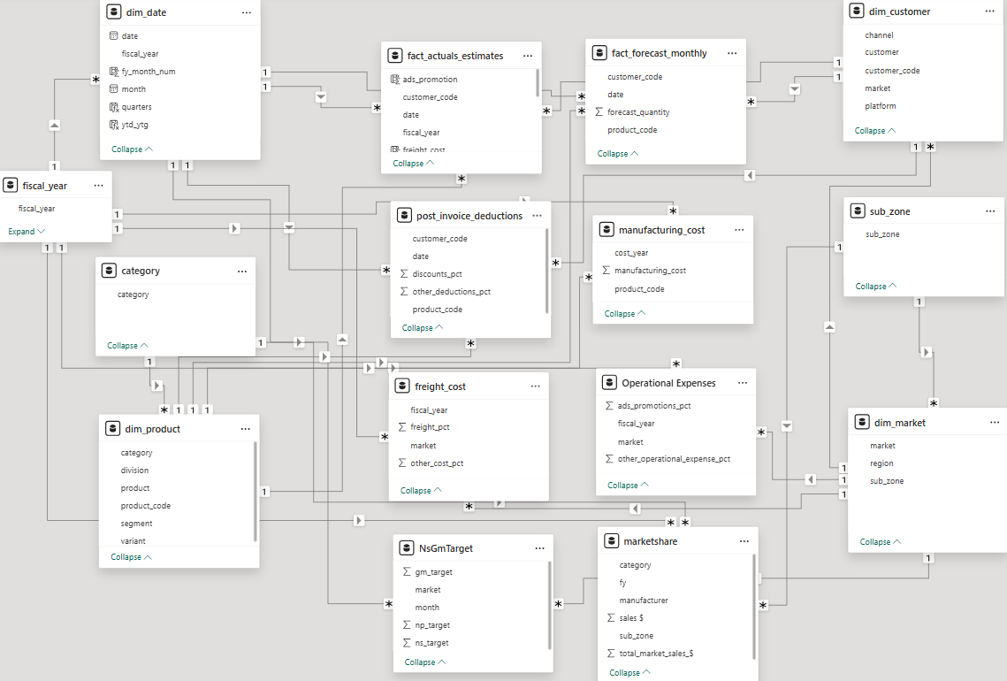
Data Model

Slide 7
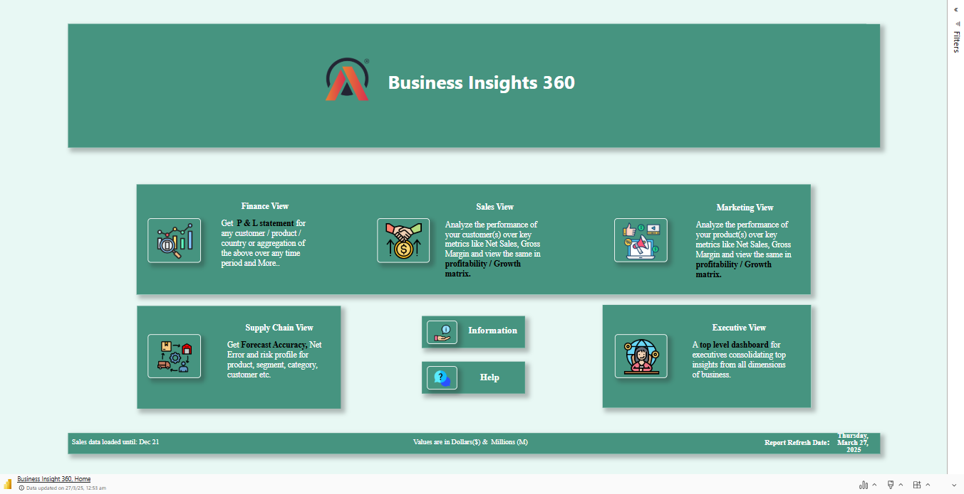
LIVE POWER BI DASHBOARD

Slide 8

THANK YOU

